Slide 1
Introduction to Data Science (CS2004)
Lecture #5
Probability Distributions

Slide 2
Today’s discussion…
Probability vs. Statistics
Concept of random variable
Probability distribution concept
Discrete probability distribution
Discrete uniform probability distribution
Binomial distribution
Multinomial distribution
Hypergeometric distribution
Poisson distribution

Slide 3
Today’s discussion
Continuous probability distribution
Continuous uniform probability distribution
Normal distribution
Standard normal distribution
Chi-squared distribution
Gamma distribution
Exponential distribution
Lognormal distribution
Weibull distribution

Slide 4
Probability and Statistics
Probability is the chance of an outcome in an experiment (also called event).
Event: Tossing a fair coin
Outcome: Head, Tail
Probability deals with predicting the likelihood of future events.
Statistics involves the analysis of the frequency of past events
Example: Consider there is a drawer containing 100 socks: 30 red, 20 blue and 50 black socks.
We can use probability to answer questions about the selection of a
random sample of these socks.
PQ1. What is the probability that we draw two blue socks or two red socks from the drawer?
PQ2. What is the probability that we pull out three socks or have matching pair?
PQ3. What is the probability that we draw five socks and they are all black?

Slide 5
Statistics
Instead, if we have no knowledge about the type of socks in the drawers, then we enter into the realm of statistics. Statistics helps us to infer properties about the population on the basis of the random sample.
Questions that would be statistical in nature are:
SQ1: A random sample of 10 socks from the drawer produced one blue, four red, five black socks. What is the total population of black, blue or red socks in the drawer?
SQ2: We randomly sample 10 socks, and write down the number of black socks and then return the socks to the drawer. The process is done for five times. The mean number of socks for each of these trial is 7. What is the true number of black socks in the drawer?
etc.

Slide 6
Probability vs. Statistics
In other words:
In probability, we are given a model and asked what kind of data we are likely to see.
In statistics, we are given data and asked what kind of model is likely to have generated it.
Example 4.1: Measles Study
A study on health is concerned with the incidence of childhood measles in parents of childbearing age in a city. For each couple, we would like to know how likely, it is that either the mother or father or both have had childhood measles.
The current census data indicates that 20% adults between the ages 17 and 35 (regardless of sex) have had childhood measles.
This give us the probability that an individual in the city has had childhood measles.

Slide 7
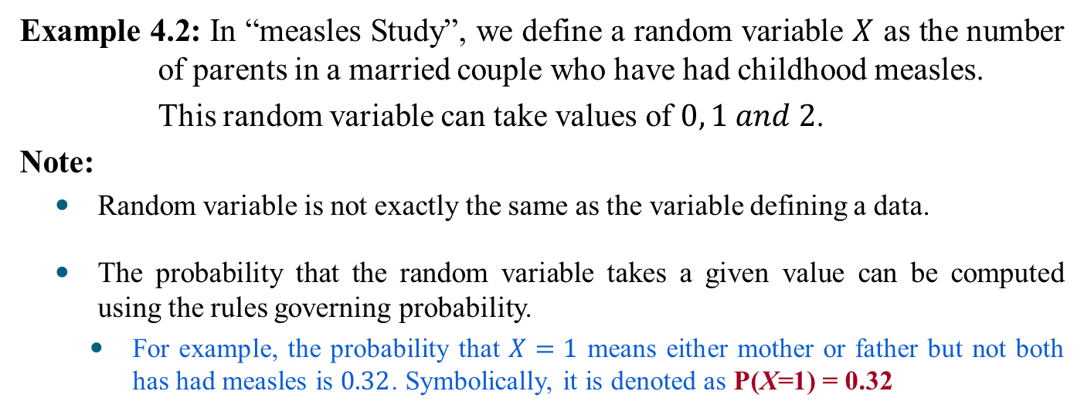
Defining Random Variable
Definition 4.1: Random Variable
A random variable is a rule that assigns a numerical value to an outcome of interest.
Example 4.2: In “measles Study”, we define a random variable $X$ as the number of parents in a married couple who have had childhood measles.
This random variable can take values of $0, 1 and 2$.
Note:
Random variable is not exactly the same as the variable defining a data.
The probability that the random variable takes a given value can be computed using the rules governing probability.
For example, the probability that $X=1$ means either mother or father but not both has had measles is $0.32$. Symbolically, it is denoted as P(X=1) = 0.32

Slide 8
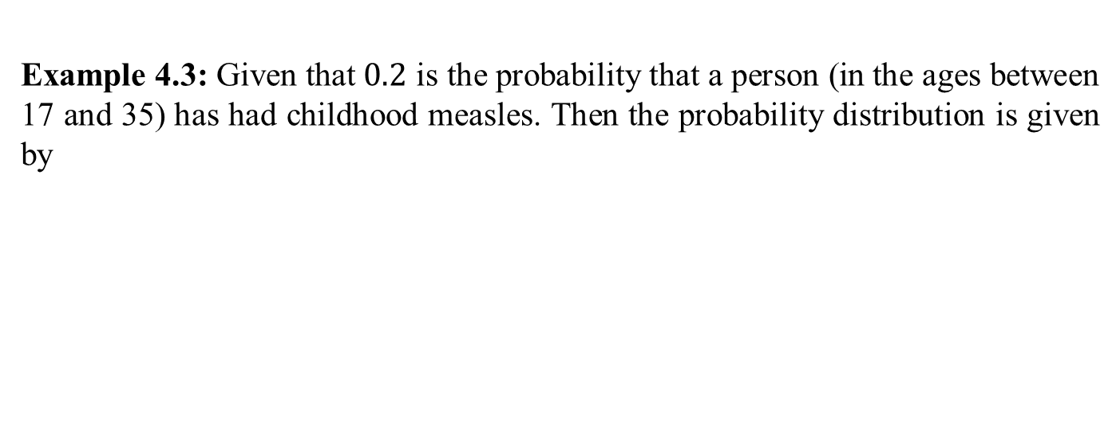
Probability Distribution
Definition 4.2: Probability distribution
A probability distribution is a definition of probabilities of the values of random variable.
Example 4.3: Given that $0.2$ is the probability that a person (in the ages between 17 and 35) has had childhood measles. Then the probability distribution is given by
X | Probability
0 | 0.64
1 | 0.32
2 | 0.04
?

Slide 9
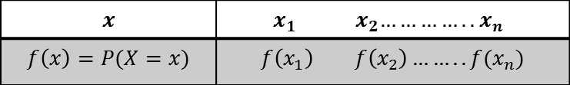
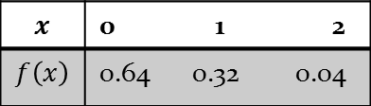
Probability Distribution
In data analytics, the probability distribution is important with which many statistics making inferences about population can be derived .
In general, a probability distribution function takes the following form
Example: Measles Study
$$x$$ | ${ x}_{1 } { x}_{2}…………..$ $x_{n}$
$$f\left(x\right)=P(X=x)$$ | $$f\left(x_{1}\right) f\left(x_{2}\right)…….. f(x_{n})$$
$$x$$ | 0 1 2
$$f\left(x\right)$$ | 0.64 0.32 0.04

Slide 10
Taxonomy of Probability Distributions
Discrete probability distributions
Binomial distribution
Multinomial distribution
Poisson distribution
Hypergeometric distribution
Continuous probability distributions
Normal distribution
Standard normal distribution
Gamma distribution
Exponential distribution
Chi square distribution
Lognormal distribution
Weibull distribution

Slide 11
Usage of Probability Distribution
Distribution (discrete/continuous) function is widely used in simulation studies.
A simulation study uses a computer to simulate a real phenomenon or process as closely as possible.
The use of simulation studies can often eliminate the need of costly experiments and is also often used to study problems where actual experimentation is impossible.
Examples 4.4:
A study involving testing the effectiveness of a new drug, the number of cured patients among all the patients who use such a drug approximately follows a binomial distribution.
Operation of ticketing system in a busy public establishment (e.g., airport), the arrival of passengers can be simulated using Poisson distribution.

Slide 12
Discrete Probability Distributions

Slide 13
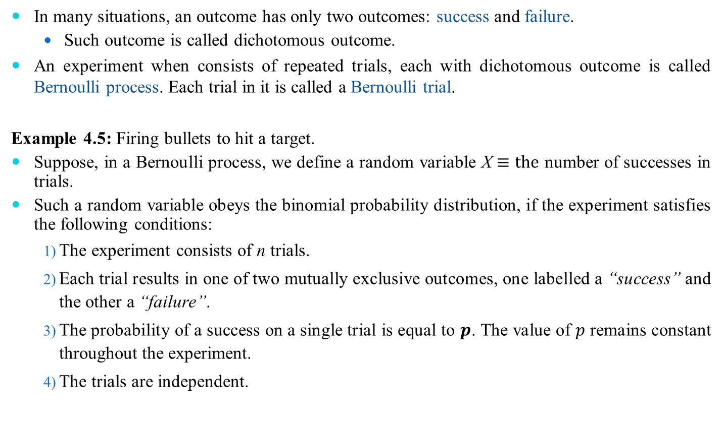
Binomial Distribution
In many situations, an outcome has only two outcomes: success and failure.
Such outcome is called dichotomous outcome.
An experiment when consists of repeated trials, each with dichotomous outcome is called Bernoulli process. Each trial in it is called a Bernoulli trial.
Example 4.5: Firing bullets to hit a target.
Suppose, in a Bernoulli process, we define a random variable X$≡the$ number of successes in trials.
Such a random variable obeys the binomial probability distribution, if the experiment satisfies the following conditions:
The experiment consists of n trials.
Each trial results in one of two mutually exclusive outcomes, one labelled a “success” and the other a “failure”.
The probability of a success on a single trial is equal to $p$. The value of $p$ remains constant throughout the experiment.
The trials are independent.

Slide 14
Binomial Probability Distribution
A fixed number of observations (trials), n
e.g., 15 tosses of a coin; 20 patients; 1000 people surveyed
A binary random variable
e.g., head or tail in each toss of a coin; defective or not defective light bulb
Generally called “success” and “failure”
Probability of success is p, probability of failure is 1 – p
Constant probability for each observation
e.g., Probability of getting a tail is the same each time we toss the coin

Slide 15
Binomial example
Take the example of 5 coin tosses. What’s the probability that you flip exactly 3 heads in 5 coin tosses?

Slide 16
Binomial distribution
Solution:
One way to get exactly 3 heads: HHHTT
What’s the probability of this exact arrangement?
P(heads)xP(heads) xP(heads)xP(tails)xP(tails) =(1/2)³ x (1/2)²
Another way to get exactly 3 heads: THHHT
Probability of this exact outcome = (1/2)¹ x (1/2)³ x (1/2)¹ = (1/2)³ x (1/2)²

Slide 17
Binomial distribution
In fact, (1/2)³ x (1/2)² is the probability of each unique outcome that has exactly 3 heads and 2 tails.
So, the overall probability of 3 heads and 2 tails is:
(1/2)³ x (1/2)² + (1/2)³ x (1/2)² + (1/2)³ x (1/2)² + ….. for as many unique arrangements as there are—but how many are there??

Slide 18
Outcome Probability
THHHT (1/2)³ x (1/2)²
HHHTT (1/2)³ x (1/2)²
TTHHH (1/2)³ x (1/2)²
HTTHH (1/2)³ x (1/2)²
HHTTH (1/2)³ x (1/2)²
THTHH (1/2)³ x (1/2)²
HTHTH (1/2)³ x (1/2)²
HHTHT (1/2)³ x (1/2)²
THHTH (1/2)³ x (1/2)²
HTHHT (1/2)³ x (1/2)²
10 arrangements x (1/2)³ x (1/2)²
The probability of each unique outcome (note: they are all equal)
ways to arrange 3 heads in 5 trials
₅C₃ = 5!/3!2! = 10

Slide 19
∴P(3 heads and 2 tails) = x P(heads)³ x P(tails)² =
10 x (½)⁵⁼31.25%

Slide 20
Binomial distribution function: X= the number of heads tossed in 5 coin tosses
p(x)
p(x)
x
0
1
2
3
4
5
number of heads
number of heads

Slide 21
Cont’d…
A fixed number of trials; e.g. roll a die three times or flip a coin five times.
each trial has two possible outcomes: success or failure. Note the die example seems like it should have six outcomes. We need to consider something like “get a 6” (success) or “not get a 6” (failure).
The probability of success must be constant (the same for each trial. In the die example, P(6) =1/6 for each roll.
The trials are independent. The outcome of one does not affect the probability of success on succeeding trials.

Slide 22
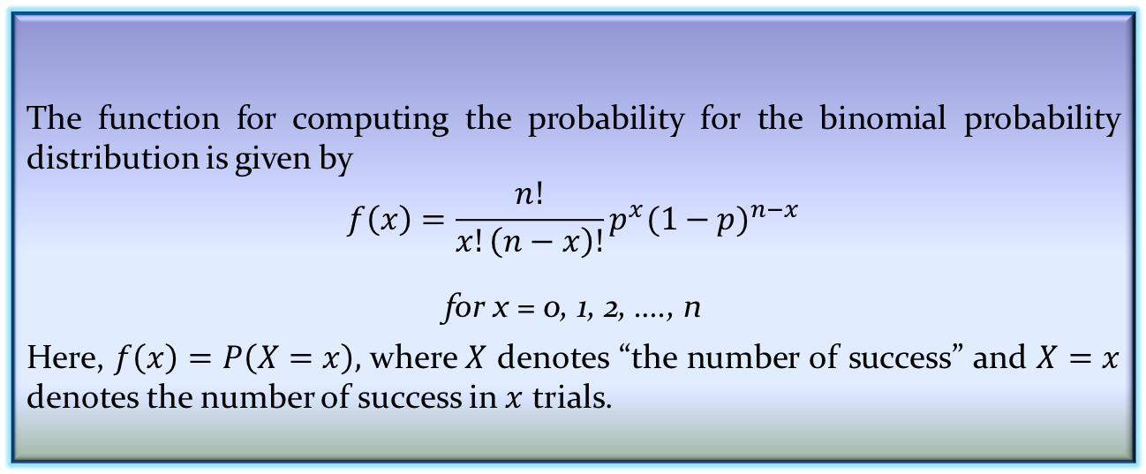
Defining Binomial Distribution
Definition 4.3: Binomial distribution
The function for computing the probability for the binomial probability distribution is given by
$$f\left(x\right)=\frac{n!}{x!\left(n−x\right)!}p^{x}{(1−p)}^{n−x}$$
for x = 0, 1, 2, …., n
Here, $f\left(x\right)=P\left(X=x\right),$where $X$ denotes “the number of success” and $X=x$ denotes the number of success in $x$ trials.

Slide 23
Binomial distribution, generally
Note the general pattern emerging → if you have only two possible outcomes (call them 1/0 or yes/no or success/failure) in n independent trials, then the probability of exactly X “successes”=
n = number of trials
1-p = probability of failure
X = # successes out of n trials
p = probability of success

Slide 24
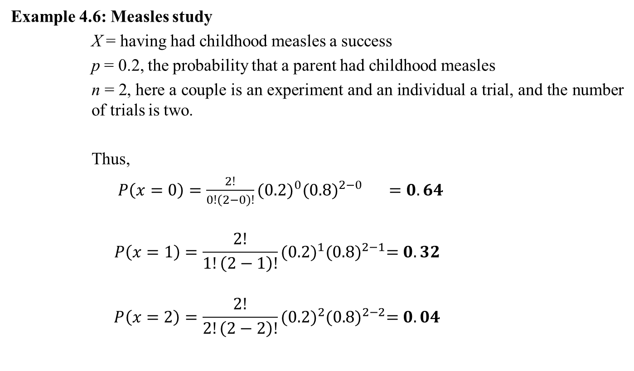
Binomial Distribution
Example 4.6: Measles study
X = having had childhood measles a success
p = 0.2, the probability that a parent had childhood measles
n = 2, here a couple is an experiment and an individual a trial, and the number of trials is two.
Thus,
$P\left(x=0\right)=\frac{2!}{0!\left(2−0\right)!}{(0.2)}^{0}{(0.8)}^{2−0} =0.64$
$$P\left(x=1\right)=\frac{2!}{1!\left(2−1\right)!}{(0.2)}^{1}{(0.8)}^{2−1}=0.32$$
$$P\left(x=2\right)=\frac{2!}{2!\left(2−2\right)!}{(0.2)}^{2}{(0.8)}^{2−2}=0.04$$

Slide 25
Binomial Distribution
Example 4.7: Verify with real-life experiment
Suppose, 10 pairs of random numbers are generated by a computer (Monte-Carlo method)
15 38 68 39 49 54 19 79 38 14
If the value of the digit is 0 or 1, the outcome is “had childhood measles”, otherwise, (digits 2 to 9), the outcome is “did not”.
For example, in the first pair (i.e., 15), representing a couple and for this couple, x = 1. The frequency distribution, for this sample is
Note: This has close similarity with binomial probability distribution!
x | 0 | 1 | 2
f(x)=P(X=x) | 0.7 | 0.3 | 0.0

Slide 26
Definitions: Binomial
Binomial: Suppose that n independent experiments, or trials, are performed, where n is a fixed number, and that each experiment results in a “success” with probability p and a “failure” with probability 1-p. The total number of successes, X, is a binomial random variable with parameters n and p.
We write: X ~ Bin (n, p) {reads: “X is distributed binomially with parameters n and p}
And the probability that X=r (i.e., that there are exactly r successes) is:

Slide 27
Definitions: Bernouilli
Bernouilli trial: If there is only 1 trial with probability of success p and probability of failure 1-p, this is called a Bernouilli distribution. (special case of the binomial with n=1)
Probability of success:
Probability of failure:

Slide 28
Binomial distribution: example
If I toss a coin 20 times, what’s the probability of getting exactly 10 heads?

Slide 29
Binomial distribution: example
If I toss a coin 20 times, what’s the probability of getting of getting 2 or fewer heads?

Slide 30
**All probability distributions are characterized by an expected value and a variance:
If X follows a binomial distribution with parameters n and p: X ~ Bin (n, p)
Then:
μ_{x}= E(X) = np
σ_{x}² =Var (X) = np(1-p)
σ_{x} =SD (X)=
Note: the variance will always lie between
0*N-.25 *N
p(1-p) reaches maximum at p=.5
P(1-p)=.25

Slide 31
Characteristics of Bernouilli distribution
For Bernouilli (n=1)
E(X) = p
Var (X) = p(1-p)

Slide 32
Recall coin toss example
X= number of heads in 100 tosses of a coin
X ~ Bin (100, .5)
E(x) = 100*.5=50
Var(X) = 100*.5*.5 = 25
SD(X) = 5

Slide 33
A brief distraction: Pascal’s Triangle Trick
You’ll rarely calculate the binomial by hand. However, it is good to know how to …
Pascal’s Triangle Trick for calculating binomial coefficients
Recall from math in your past that Pascal’s Triangle is used to get the coefficients for binomial expansion…
For example, to expand: (p + q)⁵
The powers follow a set pattern: p⁵ + p⁴q¹ + p³q² + p²q³+ p¹q⁴+ q⁵
But what are the coefficients?
Use Pascal’s Magic Triangle…

Slide 34
Pascal’s Triangle
Edges are all 1’s
1
1 1
1 2 1
1 3 3 1
1 4 6 4 1
1 5 10 10 5 1
1 6 15 20 15 6 1
1 7 21 35 35 21 7 1
To get the coefficient for expanding to the 5th power, use the row that starts with 5.
Add the two numbers in the row above to get the number below, e.g.:
3+1=4; 5+10=15
(p + q)⁵ = 1p⁵ + 5p⁴q¹ + 10p³q² + 10p²q³+ 5p¹q⁴+ 1q⁵

Slide 35
Same coefficients for X~Bin(5,p)
For example, X=# heads in 5 coin tosses:
X
P(X)
0
1
2
From line 5 of Pascal’s triangle!
3
4
5

Slide 36
Relationship between binomial probability distribution and binomial expansion
P(X=0)
P(X=1)
P(X=2)
P(X=3)
P(X=4)
P(X=5)

Slide 37
Practice problems
If the probability of being a smoker among a group of cases with lung cancer is .6, what’s the probability that in a group of 8 cases you have less than 2 smokers? More than 5?
What are the expected value and variance of the number of smokers?

Slide 38
Answer
1
1 1
1 2 1
1 3 3 1
1 4 6 4 1
1 5 10 10 5 1
1 6 15 20 15 6 1
1 7 21 35 35 21 7 1
1 8 28 56 70 56 28 8 1

Slide 39
Answer, continued
0
1
2
3
4
5
6
7
8

Slide 40
Answer, continued
P(<2)=.00065 + .008 = .00865
P(>5)=.21+.09+.0168 = .3168
0
1
2
3
4
5
6
7
8
E(X) = 8 (.6) = 4.8
Var(X) = 8 (.6) (.4) =1.92
StdDev(X) = 1.38

Slide 41
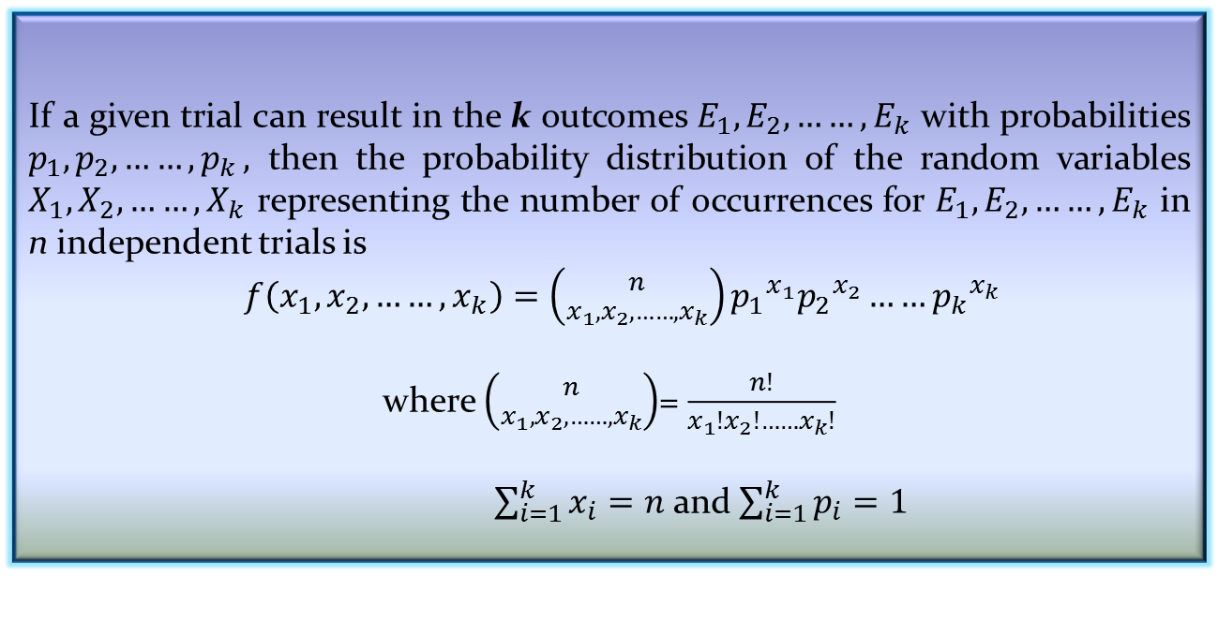
The Multinomial Distribution
The binomial experiment becomes a multinomial experiment, if we let each trial has more than two possible outcome.
Definition 4.4: Multinomial distribution
If a given trial can result in the k outcomes $E_{1}, E_{2}, ……,E_{k}$ with probabilities $p_{1}, p_{2}, ……{,p}_{k},$ then the probability distribution of the random variables $X_{1}, X_{2}, ……{,X}_{k}$ representing the number of occurrences for $E_{1}, E_{2}, ……,E_{k}$ in n independent trials is
$f\left(x_{1}, x_{2}, ……,x_{k}\right)=\left({n \atop x_{1}, x_{2}, ……,x_{k}}\right){p_{1}}^{x_{1}}{p_{2}}^{x_{2}}……{p_{k}}^{x_{k}}$
where $\left({n \atop x_{1}, x_{2}, ……,x_{k}}\right)$= $\frac{n!}{x_{1}!x_{2}!……x_{k}!}$
$\sum_{i=1}^{k}{x_{i}=n}$ and $\sum_{i=1}^{k}{p_{i}=1}$

Slide 42
Multinomial distribution (beyond the scope of this course)
The multinomial is a generalization of the binomial. It is used when there are more than 2 possible outcomes (for ordinal or nominal, rather than binary, random variables).
Instead of partitioning n trials into 2 outcomes (yes with probability p / no with probability 1-p), you are partitioning n trials into 3 or more outcomes (with probabilities: p_{1,} p_{2,} p_{3,}..)
General formula for 3 outcomes:

Slide 43
Multinomial example
Specific Example: if you are randomly choosing 8 people from an audience that contains 50% democrats, 30% republicans, and 20% green party, what’s the probability of choosing exactly 4 democrats, 3 republicans, and 1 green party member?
You can see that it gets hard to calculate very fast! The multinomial has many uses in genetics where a person may have 1 of many possible alleles (that occur with certain probabilities in a given population) at a gene locus.

Slide 44
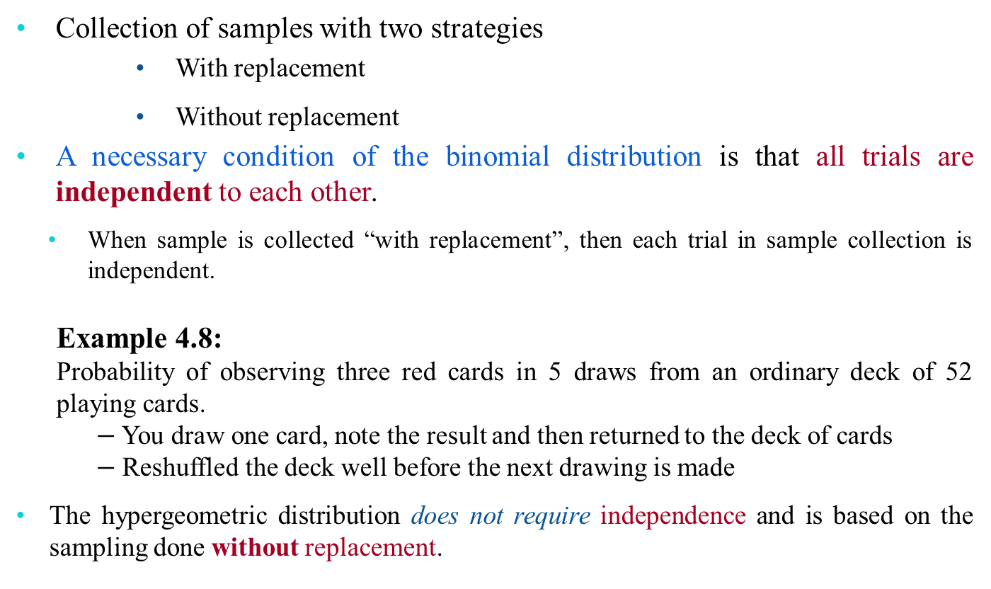
The Hypergeometric Distribution
Collection of samples with two strategies
With replacement
Without replacement
A necessary condition of the binomial distribution is that all trials are independent to each other.
When sample is collected “with replacement”, then each trial in sample collection is independent.
Example 4.8:
Probability of observing three red cards in 5 draws from an ordinary deck of 52 playing cards.
$−$You draw one card, note the result and then returned to the deck of cards
$−$ Reshuffled the deck well before the next drawing is made
The hypergeometric distribution does not require independence and is based on the sampling done without replacement.

Slide 45
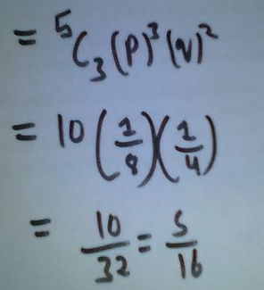
Cont’d…

Slide 46
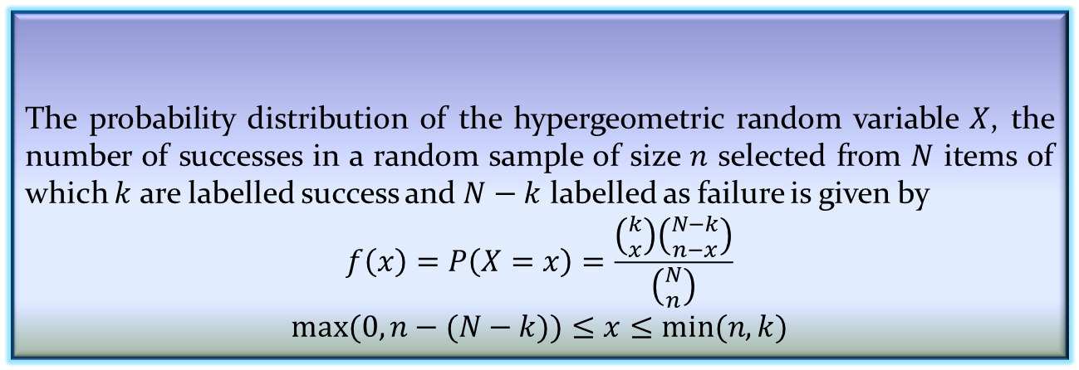
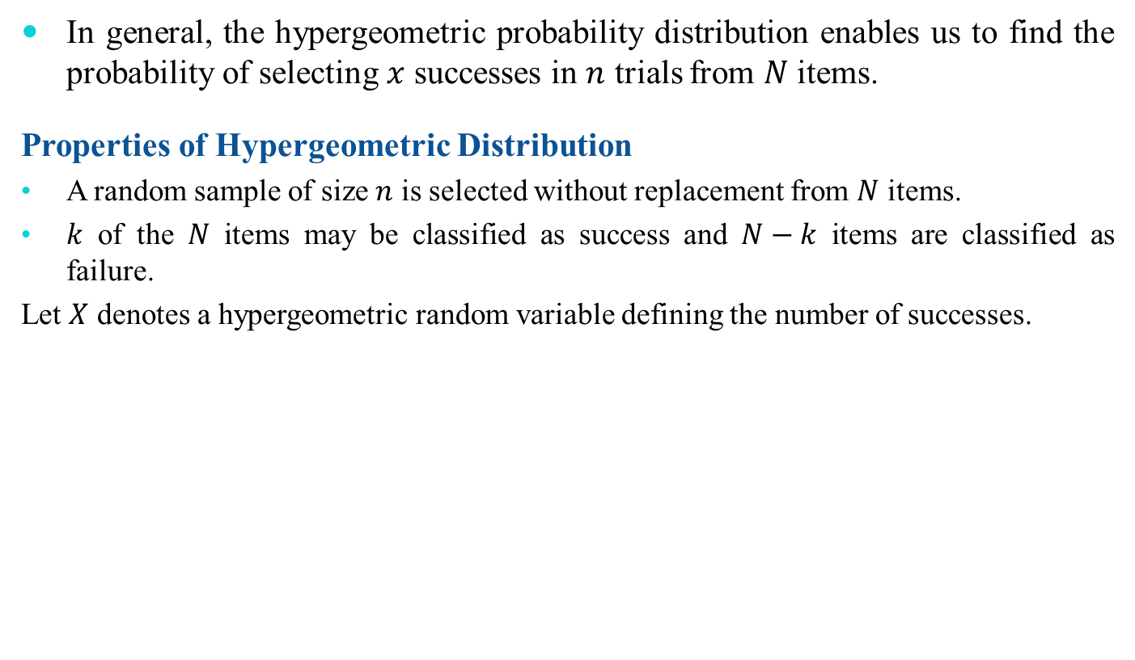
The Hypergeometric Distribution
In general, the hypergeometric probability distribution enables us to find the probability of selecting $x$ successes in $n$ trials from $N$ items.
Properties of Hypergeometric Distribution
A random sample of size $n$ is selected without replacement from $N$ items.
$k$ of the $N$ items may be classified as success and $N−k$ items are classified as failure.
Let $X$ denotes a hypergeometric random variable defining the number of successes.
Definition 4.5: Hypergeometric Probability Distribution
The probability distribution of the hypergeometric random variable $X$, the number of successes in a random sample of size $n$ selected from $N$ items of which $k$ are labelled success and $N−k$ labelled as failure is given by
$$f\left(x\right)=P\left(X=x\right)=\frac{\left({k \atop x}\right)\left({N−k \atop n−x}\right)}{\left({N \atop n}\right)}$$
$$max⁡(0, n−(N−k))≤x≤min⁡(n,k)$$

Slide 47
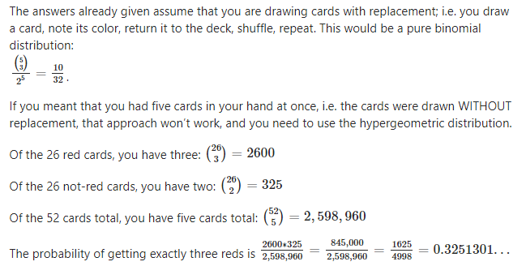
Cont’d…

Slide 48
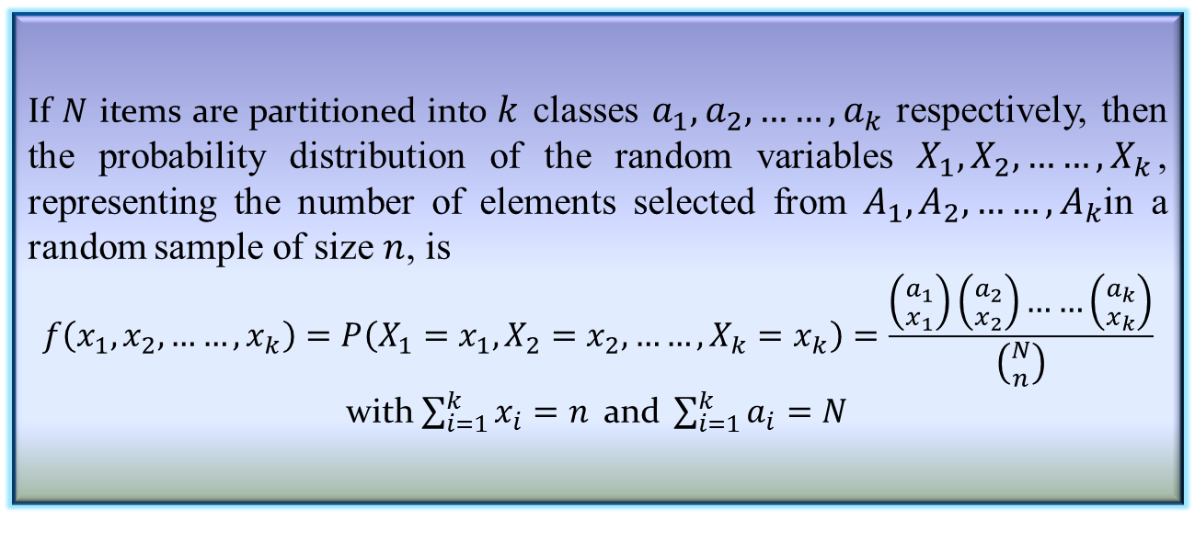
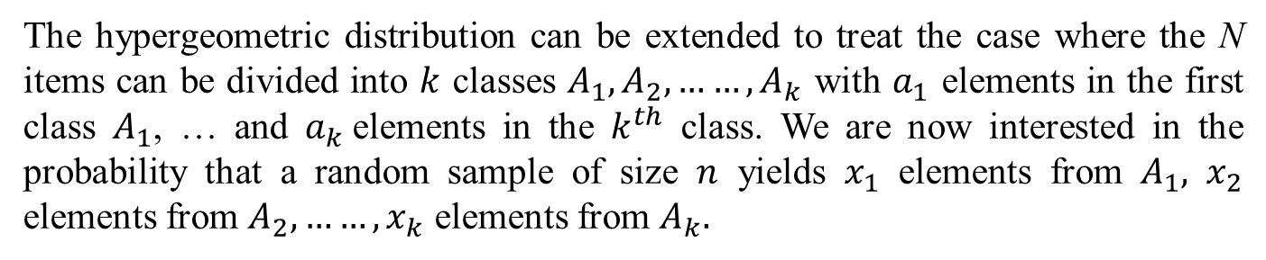
Multivariate Hypergeometric Distribution
The hypergeometric distribution can be extended to treat the case where the N items can be divided into $k$ classes $A_{1}, A_{2}, ……,A_{k}$ with $a_{1}$ elements in the first class $A_{1}$, … and $a_{k}$elements in the $k^{th}$ class. We are now interested in the probability that a random sample of size $n$ yields $x_{1}$ elements from $A_{1},$ $x_{2}$ elements from $A_{2},……,x_{k}$ elements from $A_{k}.$
Definition 4.6: Multivariate Hypergeometric Distribution
If $N$ items are partitioned into $k$ classes $a_{1}, a_{2}, ……,a_{k}$ respectively, then the probability distribution of the random variables $X_{1}, X_{2}, ……,X_{k}$, representing the number of elements selected from $A_{1}, A_{2}, ……,A_{k}$in a random sample of size $n$, is
$$f\left(x_{1}, x_{2}, ……,x_{k}\right)=P\left(X_{1}=x_{1},X_{2}=x_{2}, ……,X_{k}=x_{k}\right)=\frac{\left({a_{1} \atop x_{1}}\right)\left({a_{2} \atop x_{2}}\right)……\left({a_{k} \atop x_{k}}\right)}{\left({N \atop n}\right)}$$
with $\sum_{i=1}^{k}{x_{i}=n} \text{and} \sum_{i=1}^{k}{a_{i}=N}$

Slide 49

The Poisson Distribution
There are some experiments, which involve the occurring of the number of outcomes during a given time interval (or in a region of space).
Such a process is called Poisson process.
Example 4.9:
Number of clients visiting a ticket selling counter in a metro station.

Slide 50
Introduction to the Poisson Distribution
Poisson distribution is for counts—if events happen at a constant rate over time, the Poisson distribution gives the probability of X number of events occurring in time T.

Slide 51
Poisson Mean and Variance
Mean
For a Poisson random variable, the variance and mean are the same!
Variance and Standard Deviation
where λ = expected number of hits in a given time period

Slide 52
Poisson Distribution, example
The Poisson distribution models counts, such as the number of new cases of SARS that occur in women in New England next month.
The distribution tells you the probability of all possible numbers of new cases, from 0 to infinity.
If X= # of new cases next month and X ~ Poisson (λ), then the probability that X=k (a particular count) is:

Slide 53
Example
For example, if new cases of West Nile Virus in New England are occurring at a rate of about 2 per month, then these are the probabilities that: 0,1, 2, 3, 4, 5, 6, to 1000 to 1 million to… cases will occur in New England in the next month:

Slide 54
Poisson Probability table
X
P(X)
0
=.135
1
=.27
2
=.27
3
=.18
4
=.09
5
…
…

Slide 55
Example: Poisson distribution
Suppose that a rare disease has an incidence of 1 in 1000 person-years. Assuming that members of the population are affected independently, find the probability of k cases in a population of 10,000 (followed over 1 year) for k=0,1,2.
The expected value (mean) =λ = .001*10,000 = 10
10 new cases expected in this population per year→

Slide 56
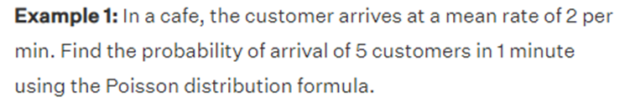

Slide 57
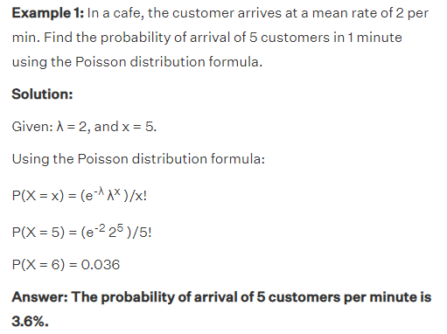

Slide 58
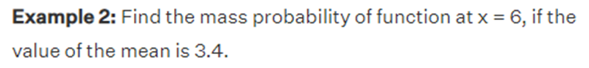

Slide 59
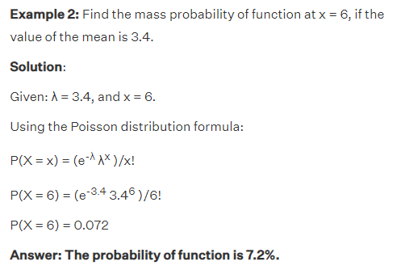

Slide 60
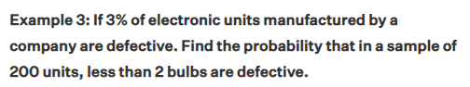

Slide 61
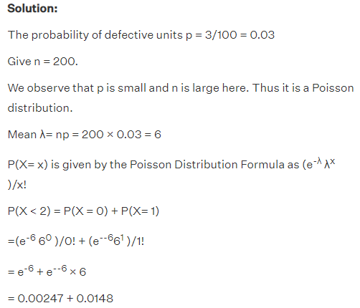

Slide 62
more on Poisson…
“Poisson Process” (rates)
Note that the Poisson parameter λ can be given as the mean number of events that occur in a defined time period OR, equivalently, λ can be given as a rate, such as λ=2/month (2 events per 1 month) that must be multiplied by t=time (called a “Poisson Process”) →
X ~ Poisson (λ)
E(X) = λt
Var(X) = λt

Slide 63
Example
For example, if new cases of West Nile in New England are occurring at a rate of about 2 per month, then what’s the probability that exactly 4 cases will occur in the next 3 months?
X ~ Poisson (λ=2/month)
Exactly 6 cases?

Slide 64
Practice problems
1a. If calls to your cell phone are a Poisson process with a constant rate λ=2 calls per hour, what’s the probability that, if you forget to turn your phone off in a 1.5 hour movie, your phone rings during that time?
1b. How many phone calls do you expect to get during the movie?

Slide 65
Answer
1a. If calls to your cell phone are a Poisson process with a constant rate λ=2 calls per hour, what’s the probability that, if you forget to turn your phone off in a 1.5 hour movie, your phone rings during that time?
X ~ Poisson (λ=2 calls/hour)
P(X≥1)=1 – P(X=0)
∴P(X≥1)=1 – .05 = 95% chance
1b. How many phone calls do you expect to get during the movie?
E(X) = λt = 2(1.5) = 3

Slide 66
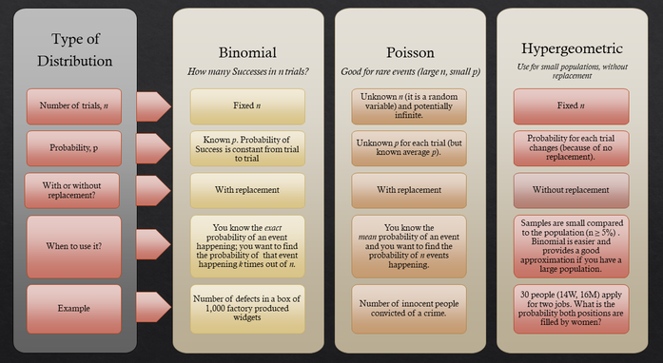

Slide 67
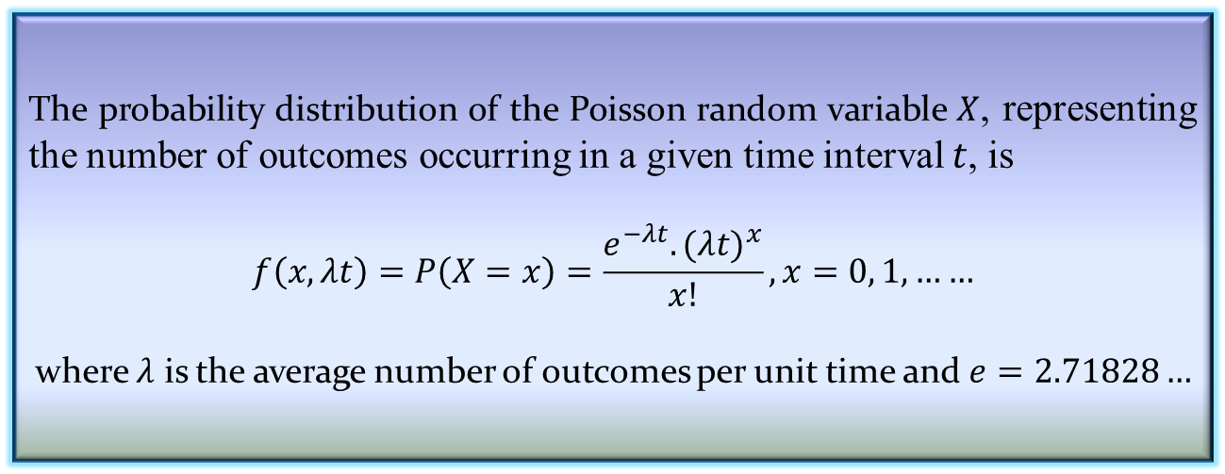
The Poisson Distribution
Properties of Poisson process
The number of outcomes in one time interval is independent of the number that occurs in any other disjoint interval [Poisson process has no memory]
The probability that a single outcome will occur during a very short interval is proportional to the length of the time interval and does not depend on the number of outcomes occurring outside this time interval.
The probability that more than one outcome will occur in such a short time interval is negligible.
Definition 4.7: Poisson distribution
The probability distribution of the Poisson random variable $X$, representing the number of outcomes occurring in a given time interval $t$, is
$$f\left(x,λt\right)=P\left(X=x\right)=\frac{e^{−λt}.{(λt)}^{x}}{x!}, x=0, 1,……$$
where $λ$ is the average number of outcomes per unit time and $e=2.71828…$

Slide 68
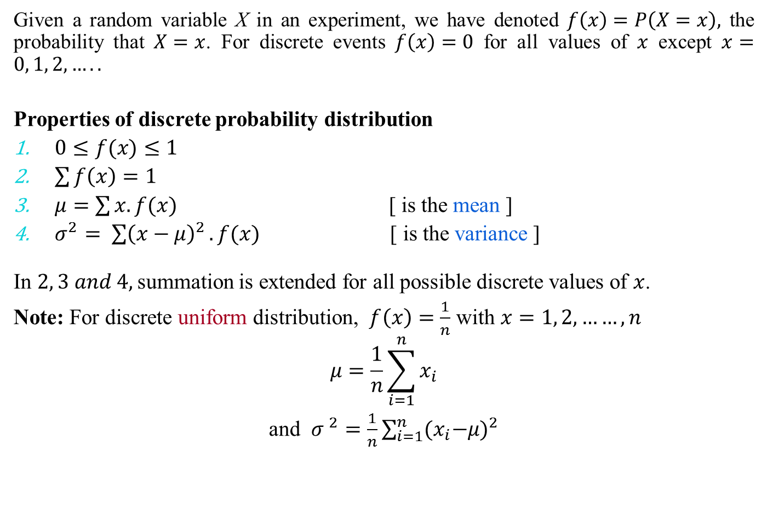
Descriptive measures
Given a random variable X in an experiment, we have denoted $f\left(x\right)=P\left(X=x\right),$ the probability that $X=x$. For discrete events $f\left(x\right)=0$ for all values of $x$ except $x=0, 1, 2,…..$
Properties of discrete probability distribution
$0≤f(x)≤1$
$\sum{f\left(x\right)=1}$
$μ=\sum{x.f(x)}$ [ is the mean ]
$σ^{2}= \sum{{\left(x−μ\right)}^{2}}.f(x)$ [ is the variance ]
In $2, 3 and 4,$summation is extended for all possible discrete values of $x$.
Note: For discrete uniform distribution, $f\left(x\right)=\frac{1}{n}$ with $x=1, 2, ……,n$
$$μ=\frac{1}{n}\sum_{i=1}^{n}{x_{i}}$$
and ${σ }^{2}=\frac{1}{n}\sum_{i=1}^{n}{{{(x}_{i}−μ)}^{2}}$

Slide 69
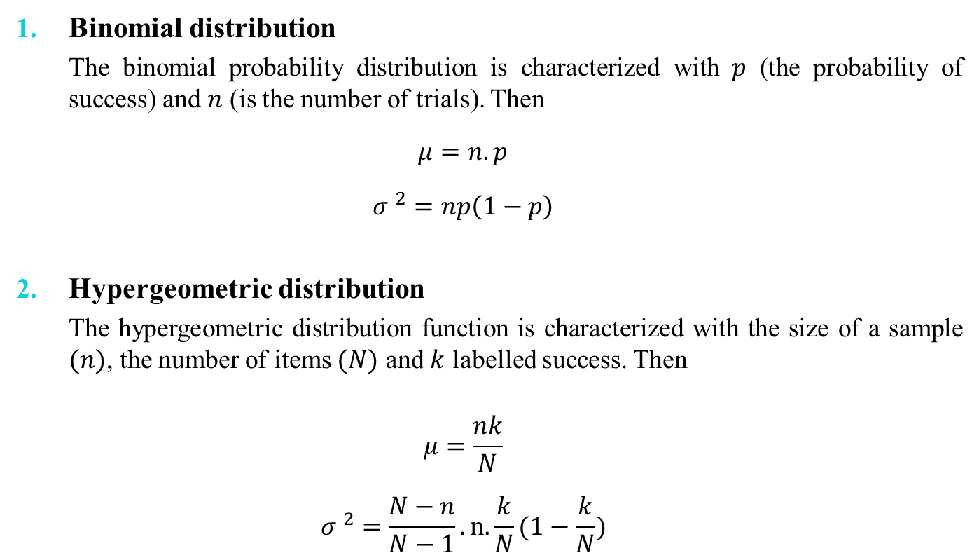
Descriptive measures
Binomial distribution
The binomial probability distribution is characterized with $p$ (the probability of success) and $n$ (is the number of trials). Then
$$μ=n.p$$
$${σ }^{2}=np\left(1−p\right)$$
Hypergeometric distribution
The hypergeometric distribution function is characterized with the size of a sample $(n)$, the number of items $(N)$ and $k$ labelled success. Then
$$μ=\frac{nk}{N}$$
$${σ }^{2}=\frac{N−n}{N−1}.n.\frac{k}{N}(1−\frac{k}{N})$$

Slide 70
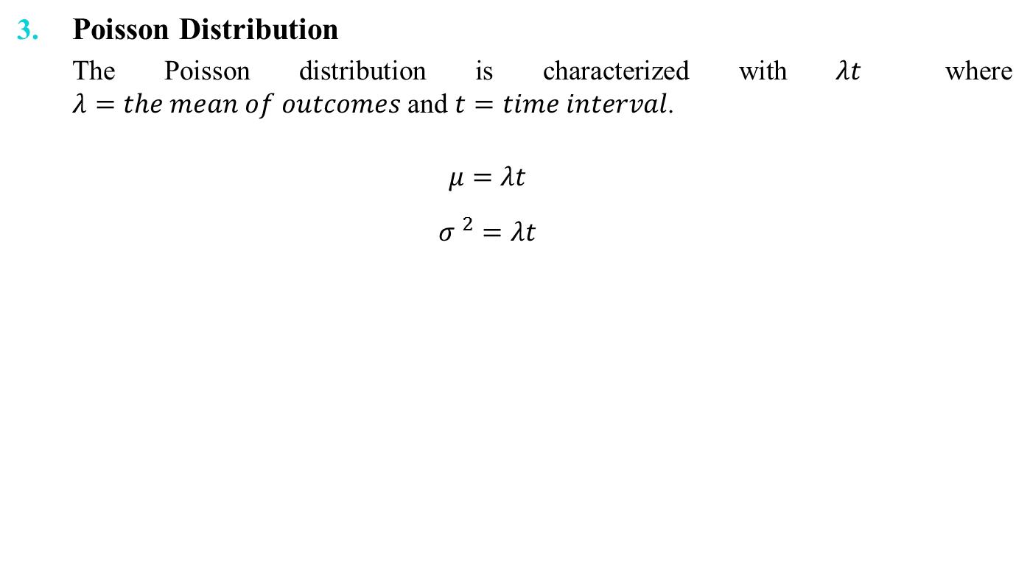
Descriptive measures
Poisson Distribution
The Poisson distribution is characterized with $λt$ where $λ=the mean of outcomes$ and $t=time interval$.
$$μ=λt$$
$${σ }^{2}=λt$$

Slide 71
Continuous Probability Distributions

Slide 72
Continuous Probability Distributions

Slide 73
Continuous Probability Distributions
When the random variable of interest can take any value in an interval, it is called continuous random variable.
Every continuous random variable has an infinite, uncountable number of possible values (i.e., any value in an interval)
Consequently, continuous random variable differs from discrete random variable.

Slide 74
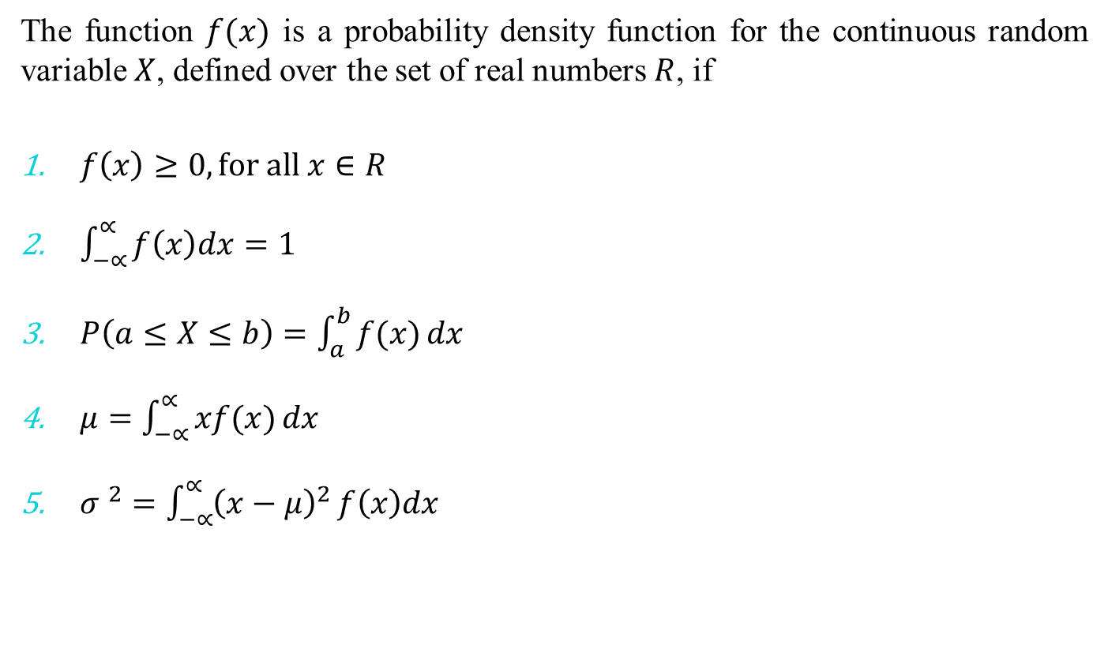
Properties of Probability Density Function
The function $f(x)$ is a probability density function for the continuous random variable $X$, defined over the set of real numbers $R$, if
$f\left(x\right)≥0, for all x∈R$
$\int_{−∝}^{∝}{f\left(x\right)dx}=1$
$P\left(a≤X≤b\right)=\int_{a}^{b}{f(x)}dx$
$μ=\int_{−∝}^{∝}{xf(x)}dx$
${σ }^{2}=\int_{−∝}^{∝}{{\left(x−μ\right)}^{2}}f\left(x\right)dx$

Slide 75
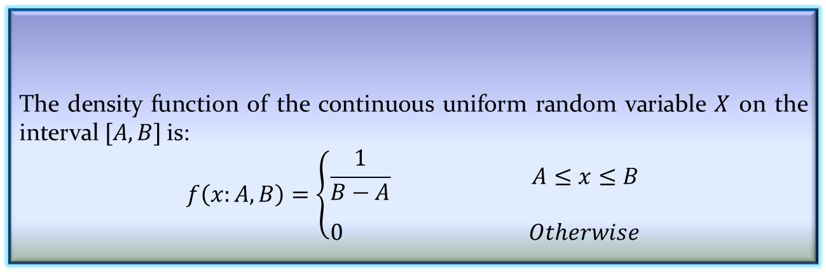
Continuous Uniform Distribution
One of the simplest continuous distribution in all of statistics is the continuous uniform distribution.
The density function of the continuous uniform random variable $X$ on the interval $[A,B]$is:
$$f\left(x:A,B\right)=\left\{\begin{aligned}\frac{1}{B−A} A≤x≤B \\ \\ 0 Otherwise\end{aligned}\right.$$
Definition 4.8: Continuous Uniform Distribution

Slide 76
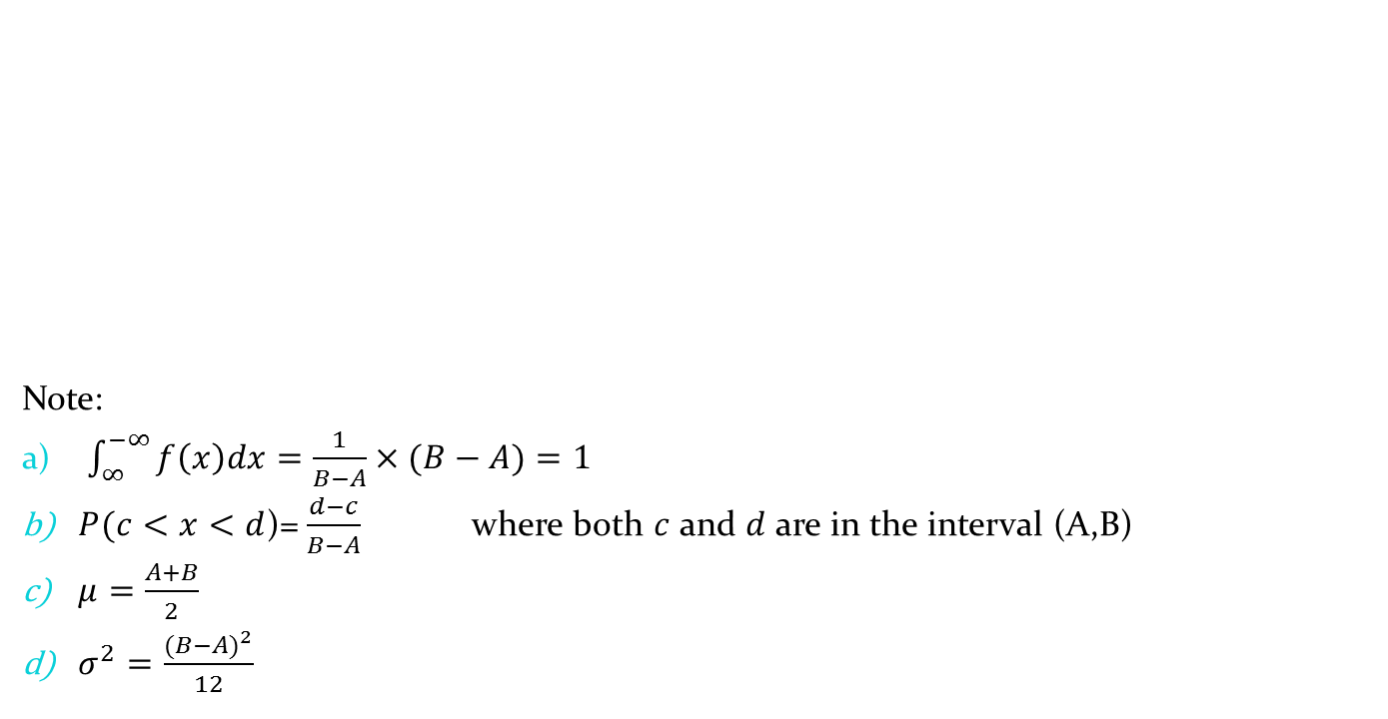
Continuous Uniform Distribution
Note:
$\int_{∞}^{−∞}{f\left(x\right)dx=\frac{1}{B−A}×(B−A)}=1$
$P(c<x<d$)=$\frac{d−c}{B−A}$ where both $c$ and $d$ are in the interval (A,B)
$μ=\frac{A+B}{2}$
$σ^{2}=\frac{{(B−A)}^{2}}{12}$

Slide 77
Normal Distribution
The most often used continuous probability distribution is the normal distribution; it is also known as Gaussian distribution.
Its graph called the normal curve is the bell-shaped curve.
Such a curve approximately describes many phenomenon occur in nature, industry and research.
Physical measurement in areas such as meteorological experiments, rainfall studies and measurement of manufacturing parts are often more than adequately explained with normal distribution.
A continuous random variable X having the bell-shaped distribution is called a normal random variable.

Slide 78
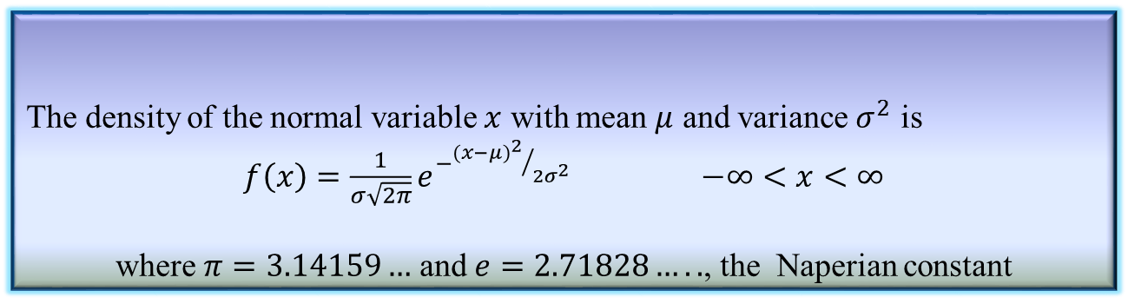
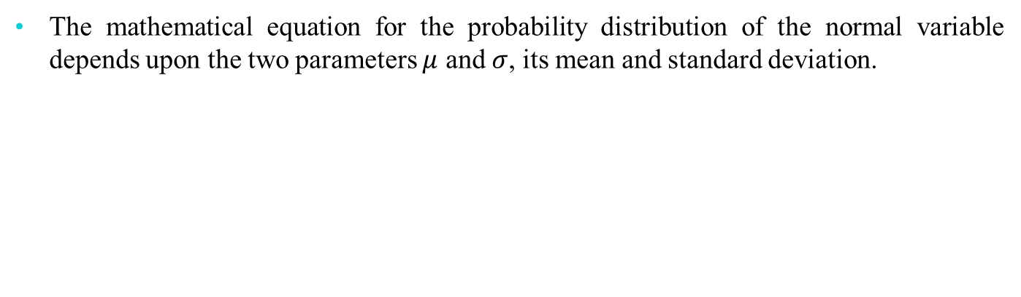
Normal Distribution
The mathematical equation for the probability distribution of the normal variable depends upon the two parameters $μ$ and $σ$, its mean and standard deviation.
Definition 4.9: Normal distribution
The density of the normal variable $x$ with mean $μ$ and variance $σ^{2}$ is
$f\left(x\right)=\frac{1}{σ\sqrt{2π}}e^{−{{(x−μ)}^{2}}/{2σ^{2}}}$ $−∞<x<∞$
where $π=3.14159…$ and $e=2.71828…..$, the Naperian constant

Slide 79
Normal Distribution

Slide 80
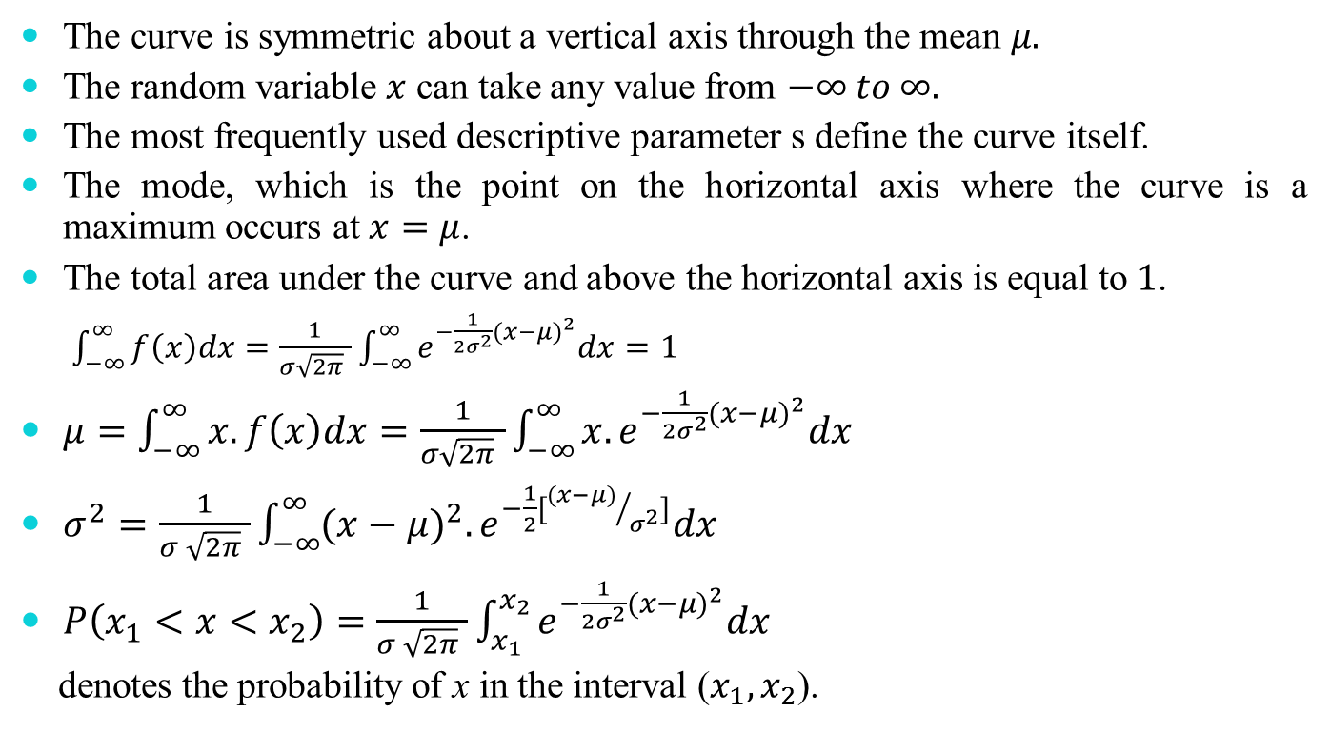
Properties of Normal Distribution
The curve is symmetric about a vertical axis through the mean $μ.$
The random variable $x$ can take any value from $−∞ to ∞.$
The most frequently used descriptive parameter s define the curve itself.
The mode, which is the point on the horizontal axis where the curve is a maximum occurs at $x=μ$.
The total area under the curve and above the horizontal axis is equal to $1$.
$\int_{−∞}^{∞}{f\left(x\right)dx=\frac{1}{σ\sqrt{2π} }\int_{−∞}^{∞}{e^{−\frac{1}{2σ^{2}}{(x−μ)}^{2}}dx}}=1$
$μ=\int_{−∞}^{∞}{x.f\left(x\right)dx=\frac{1}{σ\sqrt{2π} }\int_{−∞}^{∞}{x.e^{−\frac{1}{2σ^{2}}{(x−μ)}^{2}}dx}}$
$σ^{2}=\frac{1}{σ \sqrt{2π} }\int_{−∞}^{∞}{{(x−μ)}^{2}.e^{−\frac{1}{2}[{(x−μ)}/{σ^{2}}]}dx}$
$P\left(x_{1}<x<x_{2}\right)=\frac{1}{σ \sqrt{2π} }\int_{x_{1}}^{x_{2}}{e^{−\frac{1}{2σ^{2}}{(x−μ)}^{2}}dx}$
denotes the probability of x in the interval ($x_{1},x_{2}$).

Slide 81
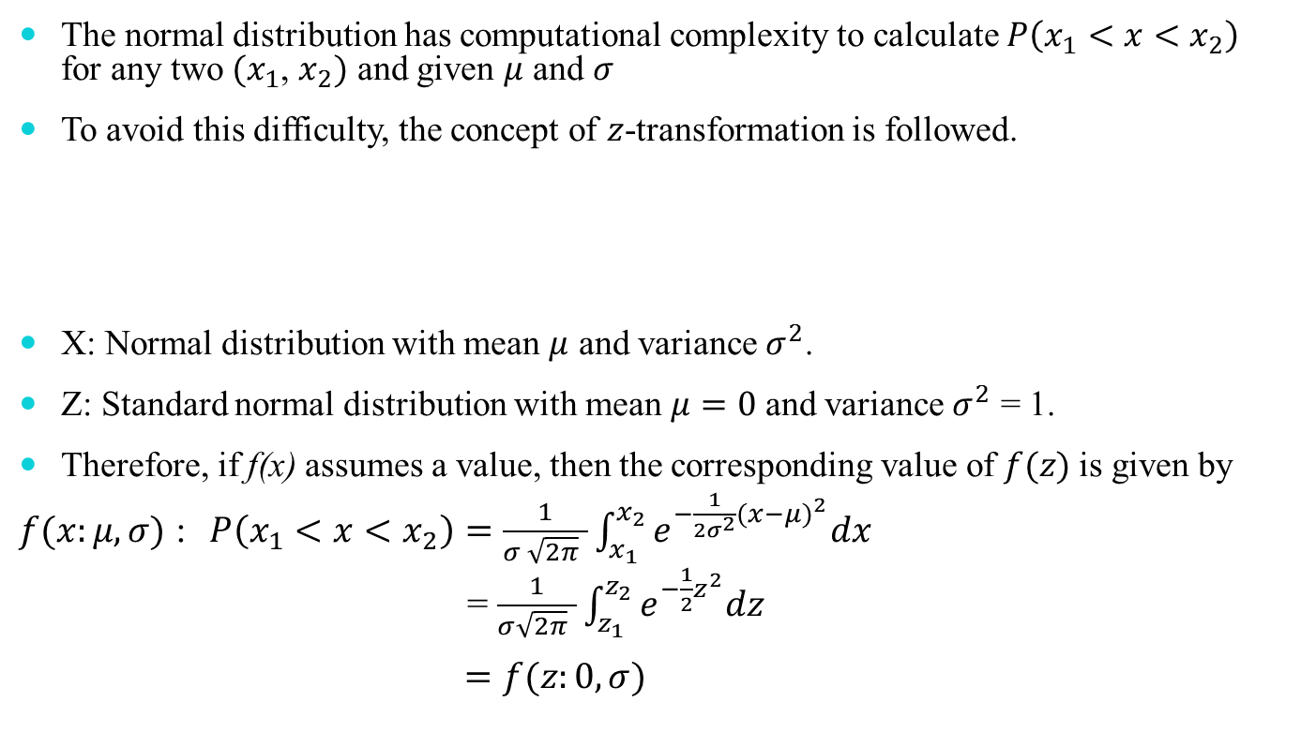
Standard Normal Distribution
The normal distribution has computational complexity to calculate $P\left(x_{1}<x<x_{2}\right)$ for any two ${(x}_{1}$, $x_{2})$ and given $μ$ and $σ$
To avoid this difficulty, the concept of $z$-transformation is followed.
X: Normal distribution with mean $μ$ and variance $σ^{2}$.
Z: Standard normal distribution with mean $μ=0$ and variance $σ^{2}$ = 1.
Therefore, if f(x) assumes a value, then the corresponding value of $f(z)$is given by
$f(x:μ,σ)$ : $P\left(x_{1}<x<x_{2}\right)=\frac{1}{σ \sqrt{2π} }\int_{x_{1}}^{x_{2}}{e^{−\frac{1}{2σ^{2}}{(x−μ)}^{2}}dx}$
= $\frac{1}{σ\sqrt{2π} }\int_{z_{1}}^{z_{2}}{e^{−\frac{1}{2}z^{2}}dz}$
$=f(z:0,σ)$
$z=\frac{x−μ}{σ}$ [Z-transformation]

Slide 82
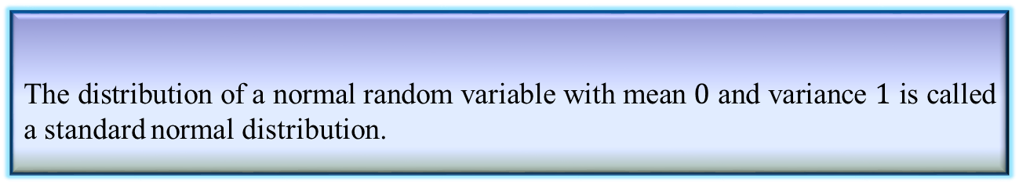
Standard Normal Distribution
Definition 4.10: Standard normal distribution
The distribution of a normal random variable with mean $0$ and variance $1$ is called a standard normal distribution.

Slide 83
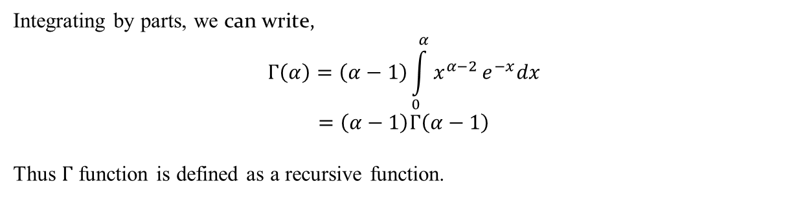

Gamma Distribution
The gamma distribution derives its name from the well known gamma function in mathematics.
Definition 4.11: Gamma Function
$Γ\left(α\right)=\int_{0}^{α}{x^{α−1}}e^{−x}dx$ for $α>0$
Integrating by parts, we can write,
$$Γ\left(α\right)=\left(α−1\right)\int_{0}^{α}{x^{α−2}}e^{−x}dx$$
$$=\left(α−1\right)Γ\left(α−1\right)$$
Thus $Γ$ function is defined as a recursive function.

Slide 84
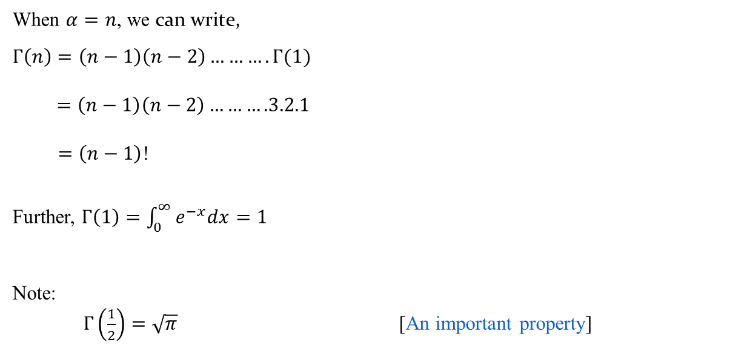
Gamma Distribution
When $α=n$, we can write,
$Γ\left(n\right)=\left(n−1\right)\left(n−2\right)……….Γ(1)$
$$=\left(n−1\right)\left(n−2\right)……….3.2.1$$
$=\left(n−1\right)$!
Further, $Γ\left(1\right)=\int_{0}^{∞}{e^{−x}dx}=1$
Note:
$Γ\left(\frac{1}{2}\right)=\sqrt{π}$ [An important property]

Slide 85
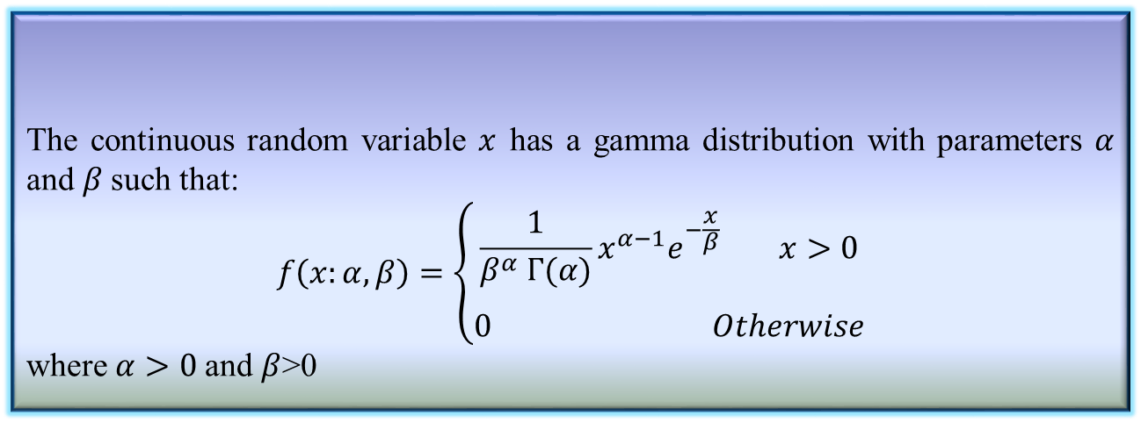
Gamma Distribution
The continuous random variable $x$ has a gamma distribution with parameters $α$ and $β$such that:
$$f\left(x:α,β\right)=\left\{\begin{aligned}\frac{1}{β^{α} Γ(α)}x^{α−1}e^{−\frac{x}{β}} x>0 \\ \\ 0 Otherwise\end{aligned}\right.$$
where $α>0$and $β$>0
Definition 4.12: Gamma Distribution

Slide 86
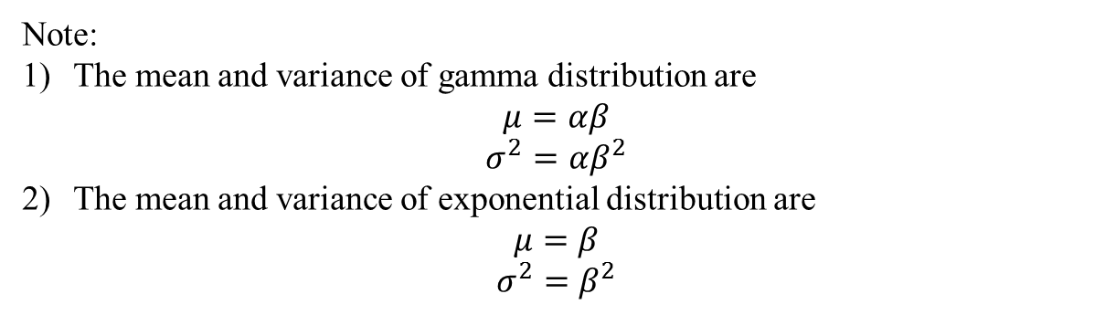
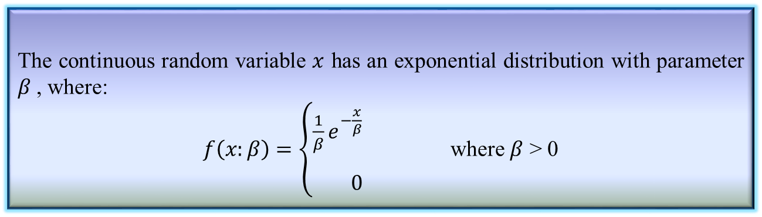
Exponential Distribution
Definition 4.13: Exponential Distribution
The continuous random variable $x$ has an exponential distribution with parameter $β$, where:
$f\left(x:β\right)=\left\{\begin{aligned}\frac{1}{β}e^{−\frac{x}{β}} \\ \\ 0\end{aligned}\right.$ where $β$ > 0
Note:
The mean and variance of gamma distribution are
$$μ=αβ$$
$$σ^{2}=αβ^{2}$$
The mean and variance of exponential distribution are
$$μ=β$$
$$σ^{2}=β^{2}$$

Slide 87
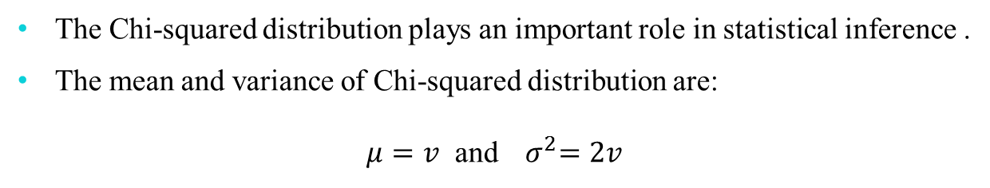
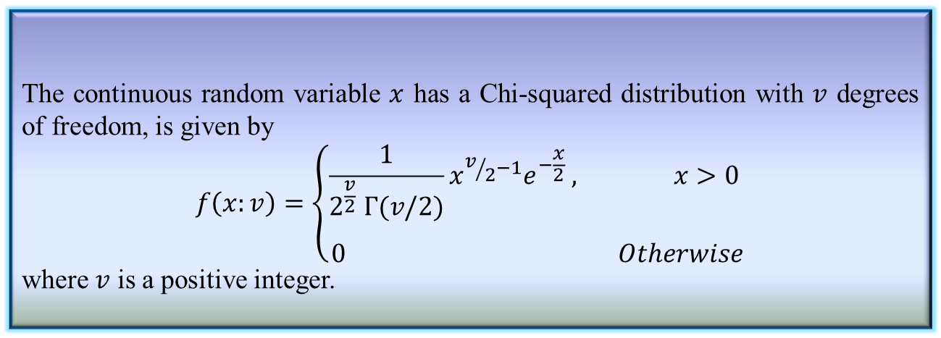
Chi-Squared Distribution
Definition 4.14: Chi-squared distribution
The continuous random variable $x$ has a Chi-squared distribution with $v$ degrees of freedom, is given by
$$f\left(x:v\right)=\left\{\begin{aligned}\frac{1}{2^{\frac{v}{2}} Γ(v/2)}{x^{v/2−1}e}^{−\frac{x}{2}} , x>0 \\ \\ 0 Otherwise\end{aligned}\right.$$
where $v$ is a positive integer.
The Chi-squared distribution plays an important role in statistical inference .
The mean and variance of Chi-squared distribution are:
$μ=v$ and${ σ}^{2}=2v$

Slide 88
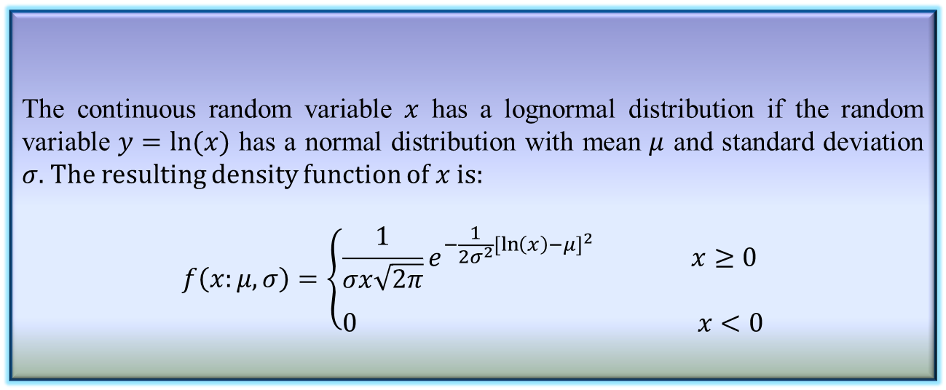
Lognormal Distribution
The lognormal distribution applies in cases where a natural log transformation results in a normal distribution.
Definition 4.15: Lognormal distribution
The continuous random variable $x$ has a lognormal distribution if the random variable $y=ln⁡(x)$ has a normal distribution with mean $μ$ and standard deviation $σ.$ The resulting density function of $x$ is:
$$f\left(x:μ,σ\right)=\left\{\begin{aligned}\frac{1}{σx\sqrt{2π}}e^{−\frac{1}{2σ^{2}}{[\ln\left(x\right)−μ]}^{2}} x≥0 \\ \\ 0 x<0\end{aligned}\right.$$

Slide 89
Lognormal Distribution

Slide 90
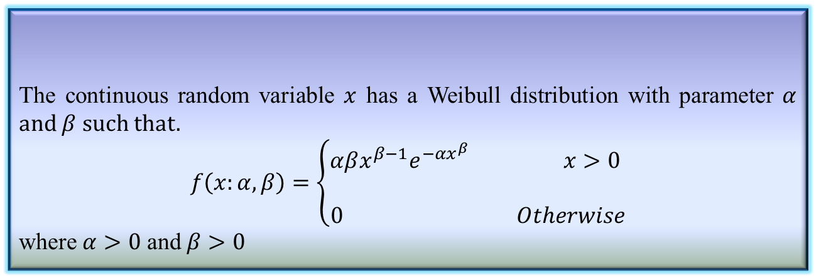
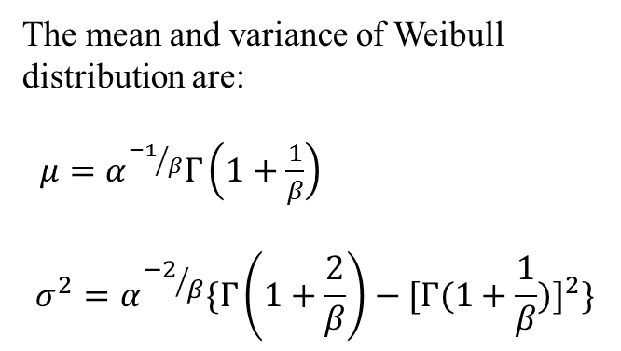
Weibull Distribution
Definition 4.16: Weibull Distribution
The continuous random variable $x$ has a Weibull distribution with parameter $α$ and $β$ such that.
$$f\left(x:α,β\right)=\left\{\begin{aligned}αβx^{β−1}e^{−αx^{β}} x>0 \\ \\ 0 Otherwise\end{aligned}\right.$$
where $α>0$ and $β>0$
The mean and variance of Weibull distribution are:
$μ=α^{{−1}/β}Γ\left(1+\frac{1}{β}\right)$
$$σ^{2}=α^{{−2}/β}\{Γ\left(1+\frac{2}{β}\right)−{[Γ(1+\frac{1}{β})]}^{2}\}$$

